Slide 1
LoRa PODWave
Thibaud Vegreville / Loris Gentillion / Zheng Jian

Slide 2
Summary :
Project idea and explanation
Technical implementation
Project state and evaluation
Conclusion and suggestion

Slide 3
Project idea :

Slide 4
Global Structure
POD
POD
LEGENDE :
Protocole LoRa
Protocole WiFi
THE IDEA :
A propagation-based algorithm wich is close in mind to a survey function.
Designed to work as fast-configured / fast-used LAN and result propagation.
POD
Client
Client
Client

Slide 5
Ideas of Application Fields.
Low-cost humanitarian devices
Long range and reliability in difficult condition
Improvised event in area not connected or poorly
Poor population or nomad ones in no-network-cover area
Sahara’s nomad.
High mountain population (e.g : Kazakhstan, Peru, etc…)

Slide 6
Technical implementation :

Slide 7
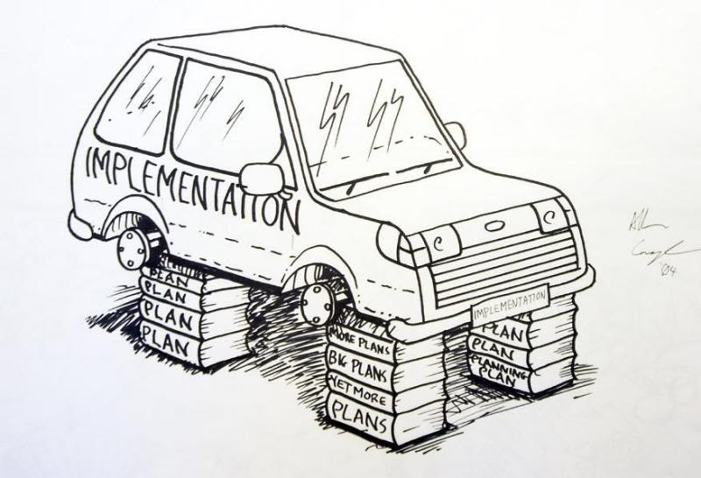
Technical Implementation :
A mobile application, used for user interaction.
A LoRa pod, which is divided in two part :
A Wifi web server used for receive and serve data request or data modification from mobile application
A radio handler for incoming and outgoing LoRa communication
Language used : C++, TypeScript, Javascript
Framework used : Angular, Ionic

Slide 8
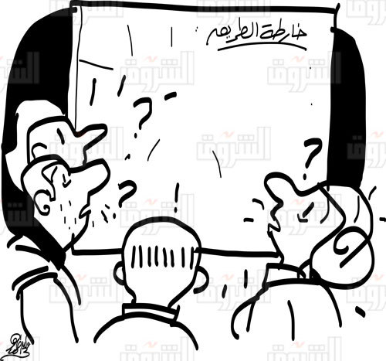
Road Map :
Mobile app side :
General interfaces
Workshop and plugin function for extensibility
POD Side:
Server and WiFi application :
Complete Web fast-configuration
Fully implemented API easy to use
Back-end access and configuration
Implement a Trigger&Survey type library.
LoRa transition :
Implement a LoRa standard for application communication
Handle error and environment variable.

Slide 9
Exemple : Survey Application

Slide 10
Project state and evaluation

Slide 11
Global overview
Mobile app. state
POD state
Interfaces
Communication with POD
Processing data
Workshop & plugin
Dynamic application setup
LoRa/Wifi setup and configuration
Minimalist Web handler
Processing data
Full API for Web server
Dynamic configuration

Slide 12
Evaluation
Mobile app.
POD
Easy to use, easy to re-use
Framework (easy to maintain)
No really black spot
Data structure easy to understand.
Road management
LoRa communication non complete
Wifi server very heavy to develop, and even more to maintain.

Slide 13
Conclusion and suggestion

Slide 14
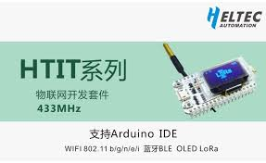
Comparison
ESP32 Helltech board
Raspberry
Very cheap
Can be connected to other hardware
Uneasy to use
Lack of library and utilities for this project.
Versatile and well-known hardware
More powerful than ESP32 hardware
Cheap, but more expansive than ESP32
Can handle a lots more library
More accessible for contributor (Open Sources goal)

Slide 15
ANY QUESTIONS ?

